Slide 1
Database Systems
Lecture: 1
Miss: Ayesha Majid

Slide 2
About the Instructor

Slide 3
Academic and Professional Experience:
Department of Software Engineering, UET Taxila (2015 – 2019)
Department of Computer Science, LUMS (2020 – 2022)
Research Area and Interest: Machine Learning and NLP
University Teaching Experience:
4 years
UETT, UMT, LUMS

Slide 4
About you Guys

Slide 5
Assessment Criteria
COURSE | LAB
QUIZ (10%) Every alternate week. (Best 6) | Lab + Viva (15%)
PROJECT/PRESENTATION (20%) | Class Participation (4%)
Mid Term (15%)
FINAL (30%)
Assignments (10%) (Best 4)
Strictly there won’t be retake of any assessments especially quizzes we will follow n-2 policy within quizzes that means if a total number of 6 quizzes are held best 4 will be considered for grading.

Slide 6

Plagiarism Policy

Slide 7
What is Plagiarism?
Plagiarism is presenting someone else’s work or ideas as your own, with or without their consent, by incorporating it into your work without full acknowledgement. All published and unpublished material, whether in manuscript, printed or electronic form, is covered under this definition. Plagiarism may be intentional or reckless, or unintentional. Under the regulations for examinations, intentional or reckless plagiarism is a disciplinary offence

Slide 8
What happens if you are thought to have plagiarized?
The plagiarism in examinations and assessments is a serious matter. Cases will be investigated, and penalties may range from deduction of marks to downgrading of your course Grade.

Slide 9
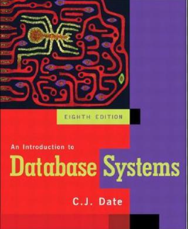
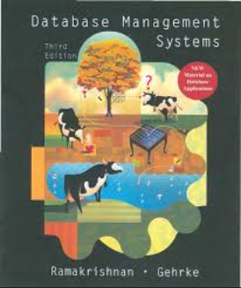
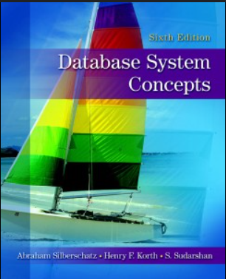
Reference Books
C. J. Date, An Introduction to Database Systems (8th Edition)
Raghu Ramakrishnan, Database Management Systems (3rd Edition)
Silberschatz Korth sudarshan, Database System Concepts (6th Edition)

Slide 10

Drive Link for Resources
https://drive.google.com/drive/folders/1grC9YzhCXp9clNIo5gH9IxTp_o7_eBKk?usp=sharing

Slide 11

WhatsApp Group:
https://chat.whatsapp.com/DlOQlRL7SrcFK0yD3ZRAul

Slide 12

Evolution from file system to Database

Slide 13
Early Days
File Systems:
Data was primarily stored in flat files. Each file was separate, leading to data redundancy and difficulty in data management.
Limitations:
Redundancy: Duplicate data across multiple files.
Inflexibility: Difficult to manage and retrieve data efficiently.
Data Integrity Issues: Lack of mechanisms to ensure data accuracy and consistency.
Hierarchical Databases:
IBM introduced the Information Management System (IMS) in 1966, which organized data in a tree-like structure.
Limitations:
Complexity: Difficult to navigate relationships between data.
Inflexibility: Rigid structure made it hard to reorganize data without significant effort.

Slide 14
Relational Databases
Data is stored in tables (relations) with defined relationships between them (e.g., MySQL, Oracle).
Reasons for Transition:
Structured Query Language (SQL): Provided a standard way to query and manipulate data.
Reduced Redundancy: Normalization techniques minimized data duplication.
Improved Integrity: Enforced data integrity through keys and constraints.

Slide 15
Summary
The transition from file systems to databases was driven by the need for better data management, integrity, flexibility, and scalability. As data complexity and volume increased, databases evolved to provide more efficient and reliable ways to store, retrieve, and manipulate information.

Slide 16
Difference between File System and Database

Slide 17
File System VS Database
A File System is a way of organizing files into groups and folders and then storing them in a storage device. It provides the media that stores data as well as enables users to perform procedures such as reading, writing, and even erasure.
On the other hand, DBMS is a more elaborate software application that is solely charged with the responsibility of managing large amounts of structured data. It provides functionalities such as query, index, transaction, as well as data integrity. Although the file system serves well for the purpose of data storage for applications where data is to be stored simply and does not require any great organization, DBMS is more appropriate for applications where data needs to be stored and optimized for organizational and structural needs, security, etc.

Slide 18
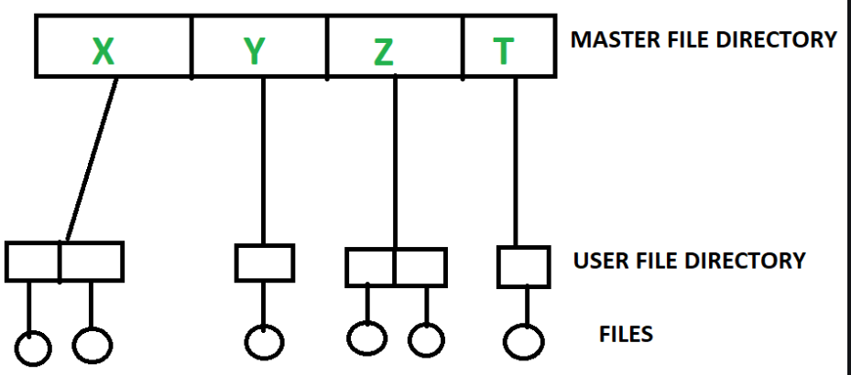
File System
The file system is basically a way of arranging the files in a storage medium like a hard disk. The file system organizes the files and helps in the retrieval of files when they are required. File systems consist of different files which are grouped into directories. The directories further contain other folders and files. The file system performs basic operations like management, file naming, giving access rules, etc.

Slide 19
Database Management System
Database Management System is basically software that manages the collection of related data. It is used for storing data and retrieving the data effectively when it is needed. It also provides proper security measures for protecting the data from unauthorized access. In Database Management System the data can be fetched by SQL queries and relational algebra. It also provides mechanisms for data recovery and data backup.

Slide 20
Difference between database and file system:
The main difference between a file system and a DBMS (Database Management System) is the way they organize and manage data.
File systems are used to manage files and directories, and provide basic operations for creating, deleting, renaming, and accessing files. They typically store data in a hierarchical structure, where files are organized in directories and subdirectories. File systems are simple and efficient, but they lack the ability to manage complex data relationships and ensure data consistency.
On the other hand, DBMS is a software system designed to manage large amounts of structured data, and provide advanced operations for storing, retrieving, and manipulating data. DBMS provides a centralized and organized way of storing data, which can be accessed and modified by multiple users or applications. DBMS offers advanced features like data validation, indexing , transactions, concurrency control , and backup and recovery mechanisms. DBMS ensures data consistency, accuracy, and integrity by enforcing data constraints, such as primary keys, foreign keys, and data types.

Slide 21
Database Structure

Slide 22
What Is the Structure of a Database?
At its simplest, a database is made up of tables that contain columns and rows.
Each row in a table is called a record, and each cell is a field. Each field (or column) holds a specific type of data, such as a number, text or a date.
This specification is enforced by a series of rules called constraints to ensure that your data is accurate and dependable.

Slide 23

Questions?

